Slide 1

Healthcare: Interactive Medical Data Transformation & Dynamic Visualization System
DSA0613-Data Handling and Data Visualization for Data Analytics
GUIDED BY:
Dr.Kumaragurubaran T,
Dr.Senthilvadivu S
SIMATS ENGINEERING
CHENNAI
PRESENTED BY:
S. Hemanth Kumar(192424025)
L. Karthik(192424206)
P. Durga Prasanth (192424246)
Department of AI&DS
SIMATS ENGINEERING
CHENNAI

Slide 2


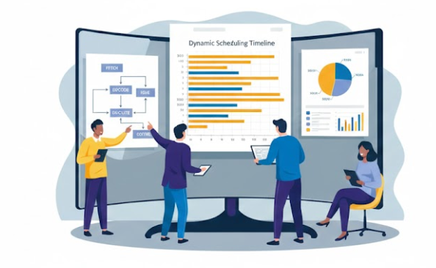
Agenda
Introduction
Problem statement
Objectives
Proposed methodology
Architecture diagram
Modules
Implementation
Conclusion
Future scope
References

Slide 3
Introduction
Healthcare generates massive, complex data that must be handled efficiently.
Raw medical data needs cleaning and transformation to be useful.
Interactive systems simplify data processing and reduce manual work.
Dynamic dashboards and visualizations reveal trends instantly.
Transformed data + visuals enable faster, smarter healthcare decisions.
Enables real-time monitoring of patients and hospital resources.
Promotes a fully data-driven approach for modern healthcare systems.
Improves data accuracy, consistency, and overall system reliability.

Slide 4
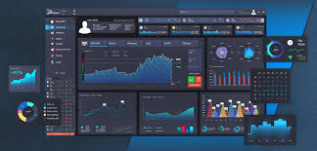
Problem statement
Challenges (Problems)
Health data is stored in many separate systems (EHR, lab, scans, wearables) that don’t talk to each other properly.
Data is often messy — missing information, repeated records, and different medical codes used for the same thing.
Dashboards are static (just charts), so doctors and analysts can’t interact or drill down easily.
Turning data insights into real actions is slow, and AI models are hard to use in real systems.
Impacts (Effects)
Doctors get information late, which can delay treatment decisions.
It’s hard to track population health, predict risks, or identify high-risk patients early.
Meeting data privacy and audit rules becomes difficult because data history and tracking are weak.

Slide 5



Objectives
3
Primary Goals (What we want to achieve)
Make all medical data uniform and usable
Show data in an easy, interactive way
Use AI/ML to support decisions
Measurable Targets :
At least 95% of data should be complete and correct
Faster results
Accurate prediction models

Slide 6
Methodology
Data Collection
Healthcare data is collected from structured sources such as CSV and JSON files containing patient, treatment, and hospital performance records. The system supports uploading datasets dynamically for analysis.
Data Preprocessing
The collected data is cleaned by removing duplicates, handling missing values, and correcting inconsistent formats. This step ensures data quality and reliability for further processing.
Data Transformation
Preprocessed data is transformed into a standardized structure. Derived attributes such as length of stay, mortality rate, readmission status, and bed occupancy are calculated to enable meaningful analysis.
Data Handling Engine Implementation
A centralized data handling engine processes the transformed data and manages efficient data flow between the backend and visualization modules.
Visualization Generation
Interactive visualizations such as bar charts, line graphs, pie charts, and heatmaps are generated using dynamic visualization libraries. All visual components are synchronized to respond to user interactions and filters

Slide 7
Methodology
Performance Metrics Computation
Key healthcare performance indicators including mortality rate, readmission rate, average length of stay, and department-wise performance are computed and prepared for comparison.
Comparative Analysis
The system compares performance metrics across departments, time periods, or datasets to identify trends, inefficiencies, and high-risk areas.
User Interaction & Dashboard Update
Users can apply filters, upload new data, and interact with dashboards. The system updates visualizations in real time based on user actions.
Result Interpretation & Validation
The generated insights are analyzed to validate system effectiveness and ensure accurate representation of healthcare performance outcomes.

Slide 8
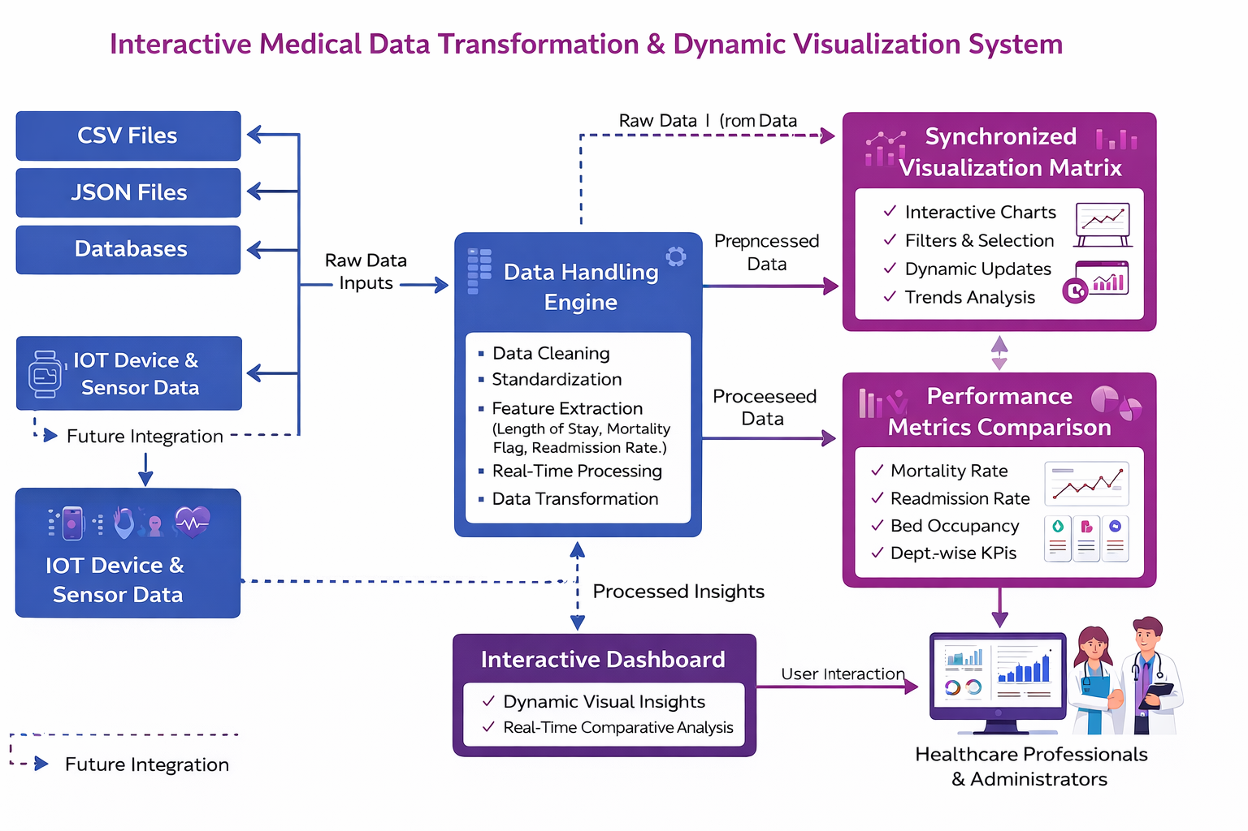
Architecture Diagram

Slide 9
Modules overview
Modules:
Module 1- Data Handling Engine & Transformation
Module 2- Synchronized Visualization matrix
module 3 - Performance Metrics & Comparison

Slide 10
Module 1- Data Handling Engine & Transformation
Collects healthcare data from multiple sources such as CSV, JSON, and databases
Cleans raw data by handling missing values, duplicates, and inconsistent formats
Transforms data into a standardized structure suitable for analysis
Performs feature extraction like length of stay, mortality flag, readmission rate, etc.
Enables real-time data processing when new records are uploaded
Acts as the core backbone that feeds reliable data to all visualization modules
DATA

Slide 11
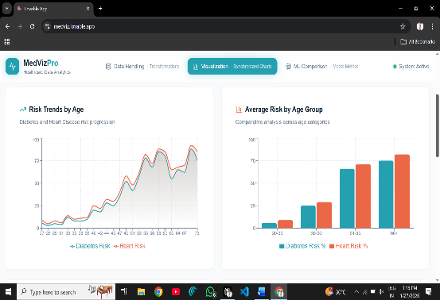
Module 2- Synchronized Visualization matrix
Converts processed data into interactive visual dashboards
Displays multiple charts such as bar charts, line graphs, pie charts, and heatmaps
Synchronizes all visualizations so filtering one chart updates all others automatically
Allows users to apply filters by department, date range, diagnosis, or outcome
Supports dynamic updates when new data is uploaded
Helps users quickly identify patterns, trends, and anomalies in healthcare data

Slide 12
Module 3 - Performance Metrics & Comparison
Calculates key healthcare KPIs like mortality rate, readmission rate, bed occupancy, and average length of stay
Compares performance across departments, time periods, or hospitals
Visualizes comparisons using side-by-side charts and KPI cards
Identifies high-risk areas and underperforming departments
Assists administrators in resource optimization and policy planning
Enables data-driven evaluation of hospital efficiency and patient outcomes

Slide 13
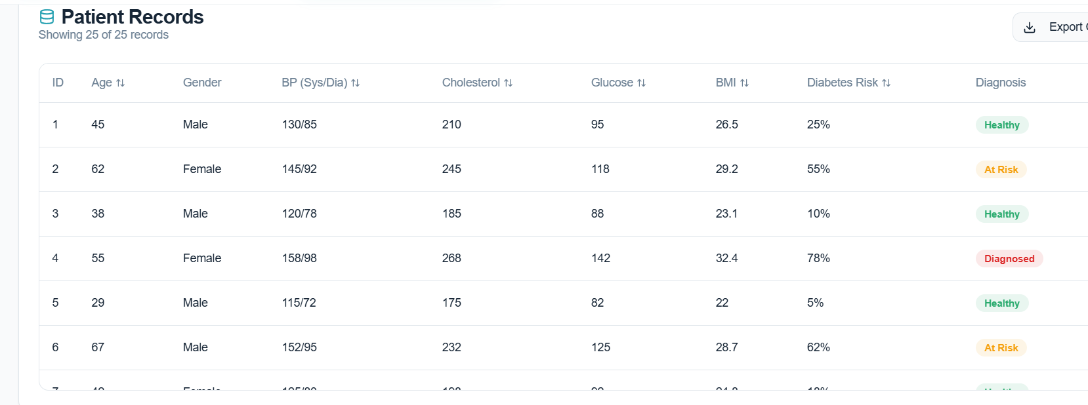
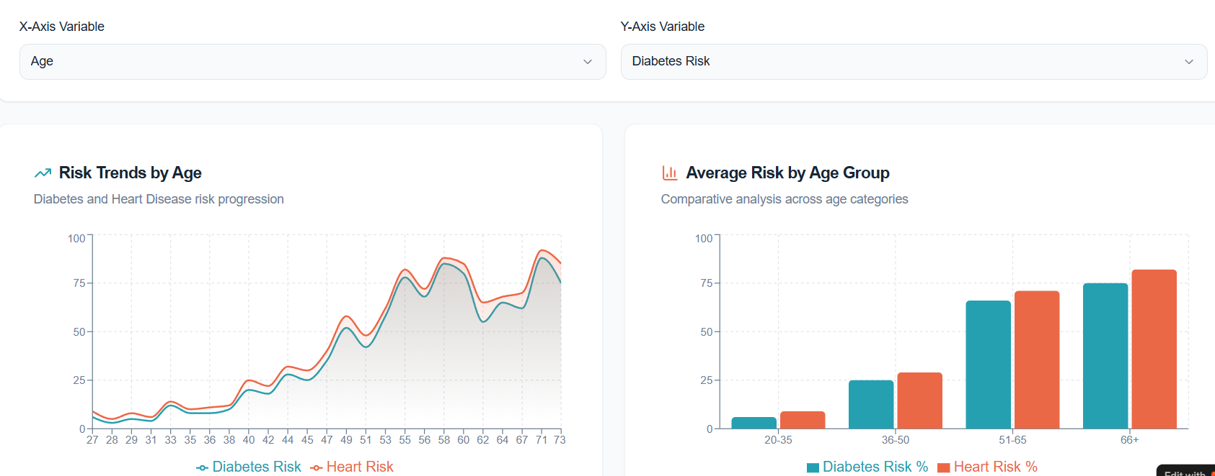
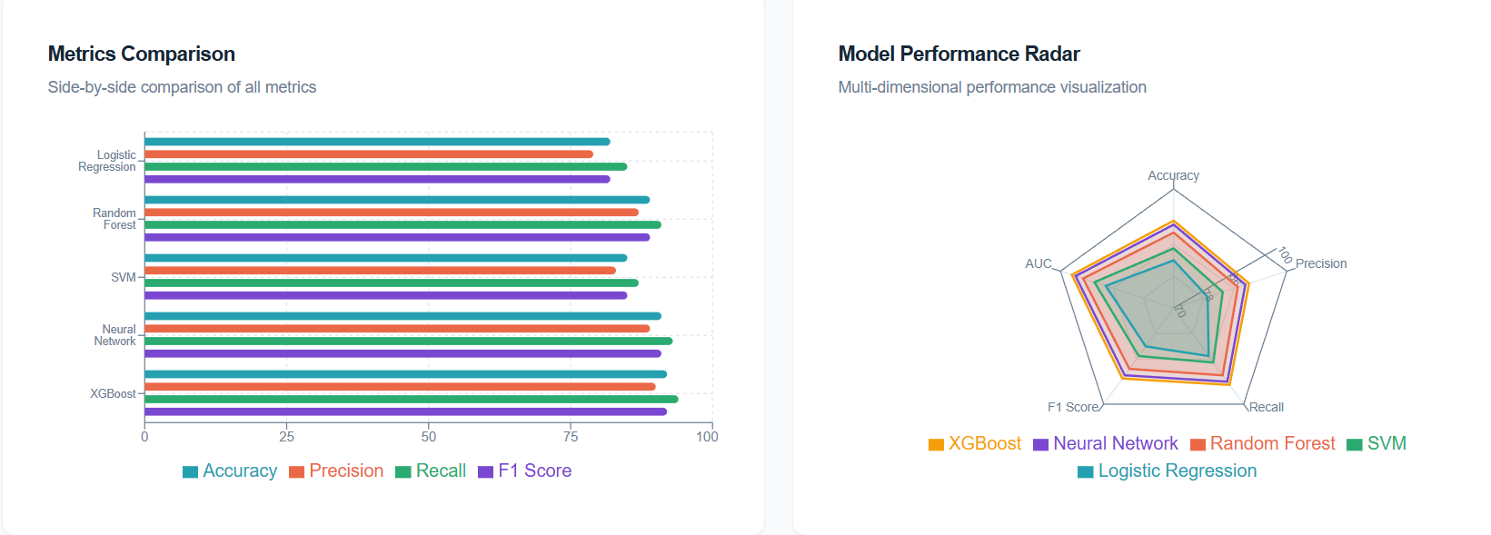
Implementation

Slide 14
Conclusion
The Interactive Medical Data Transformation & Dynamic Visualization System successfully converts raw healthcare data into meaningful insights.
The Data Handling Engine ensures accurate, clean, and standardized data processing.
The Synchronized Visualization Matrix enables real-time, interactive analysis of healthcare trends.
Performance Metrics & Comparison module supports effective evaluation of hospital efficiency and patient outcomes.
Overall, the system promotes data-driven decision-making in modern healthcare environments.
This project demonstrates how technology can enhance healthcare management and improve patient care quality.

Slide 15
Future Scope
Integration of Machine Learning models to predict patient outcomes such as mortality risk and readmission probability.
Real-time data integration from IoT medical devices and wearable sensors for continuous patient monitoring.
Expansion to support multi-hospital and regional healthcare data comparison.
Implementation of AI-driven anomaly detection to identify unusual patient patterns and medical risks early.
Enhanced data security and privacy using encryption and role-based access control.
Development of a mobile-friendly dashboard for doctors and administrators to access insights anytime.

Slide 16
References
[1] World Health Organization, Health Information Systems and Data Analytics. Geneva, Switzerland: WHO Press, 2021.
[2] J. Han, M. Kamber, and J. Pei, Data Mining: Concepts and Techniques, 3rd ed. Waltham, MA, USA: Morgan Kaufmann, 2012.
[3] Plotly Technologies Inc., “Plotly JavaScript Open Source Graphing Library,” Plotly Documentation, 2023. [Online]. Available: https://plotly.com/javascript/
[4] Python Software Foundation, “Python Documentation,” 2023. [Online]. Available: https://docs.python.org/3/
[5] A. Rajkomar, J. Dean, and I. Kohane, “Machine learning in medicine,” New England Journal of Medicine, vol. 380, no. 14, pp. 1347–1358, 2019.
[6] Healthcare Information and Management Systems Society (HIMSS), Healthcare Analytics and Data Management, HIMSS Publications, 2022.

Slide 17


